Slide 1

Price Analysis of Washing Machine

Slide 2

About us:
N.Bheema Sankar M.Sc(Physics)
M.Chinna Raidu M.Sc(Statistics)
Data science:
Data science is the study of data to extract meaningful insights to understand the data in a simple manner .
Work Experience :- Fresher

Slide 3
Contents :-
Problem statement
Tools Used
Raw data
Web Scraping
Data manipulation /Data cleaning
EDA(Exploratory Data Analysis)
Objective
Conclusion

Slide 4
Message @bheemasankar
Price Analysis based on Rating(online)
Message @bheemasankar
PROBLEM STATEMENT:
One of my friend went to purchase a washing machine, and he need to know the factors effecting its price
Price Analysis based on the different Brands.
Price Analysis based on the different Colors.
Price Analysis based on the different Load.
Price Analysis based on Top or Front.
Price Analysis based on Rating(online)

Slide 5
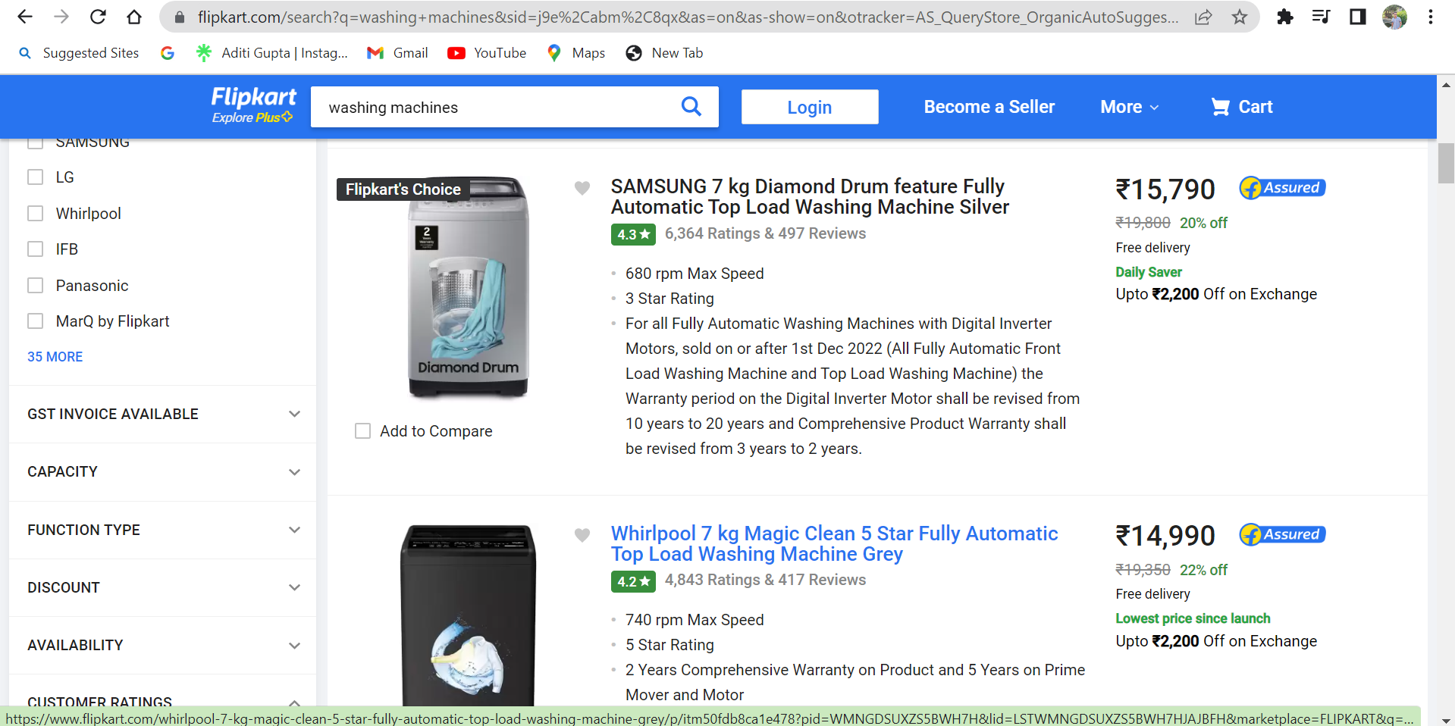
Website :-

Slide 6





NumPy
Pandas
BeautifulSoup
Requests
Matplotlib
pyplot
seaborn
TOOLS USED:

Slide 7
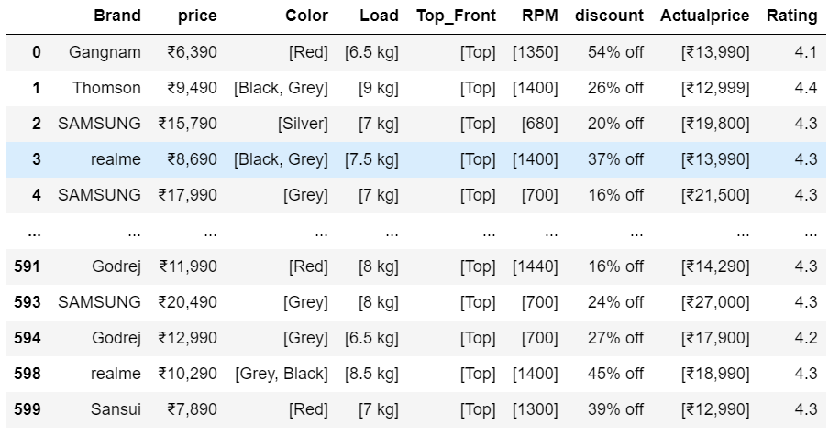
Raw Data :-

Slide 8
Data cleaning Steps :-
Check for duplicates
No duplicates found
Removing special characters
Identifing and filling or dropping the missing values
Data type conversion

Slide 9
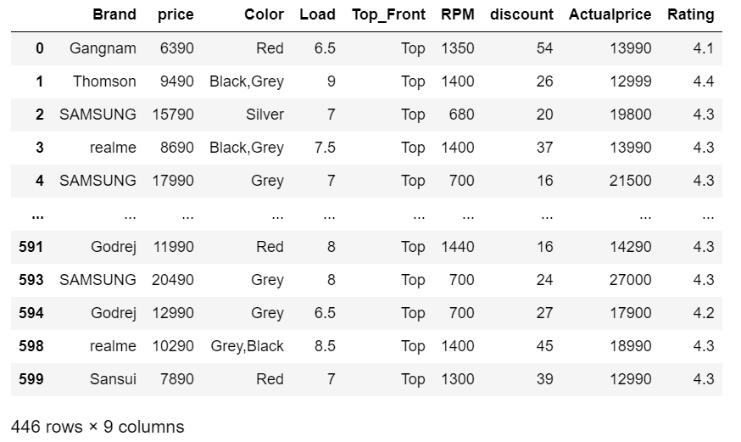
Cleaned Data :-

Slide 10
DATA VISUALIZATION
Uni-Variate Analysis:
Uni variate data consists of only one variable. The information deals with only one quantity that changes.
Categorical & Numerical
Bi-Variate Analysis:
Bivariate data involves two different variable. The analysis is done to find out the relationship among the two variables.
Categorical and Categorical , 2 Categorical and numerical ,3 Numerical and numerical
Multi-Variate analysis:
Multivariate analysis have required when more than two variables have to be analysed simultaneously.
Two Categorical and one Numerical
Two Numerical and one Categorical
Three or more Numerical

Slide 11
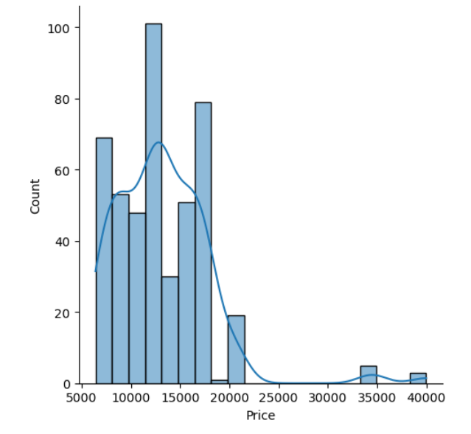
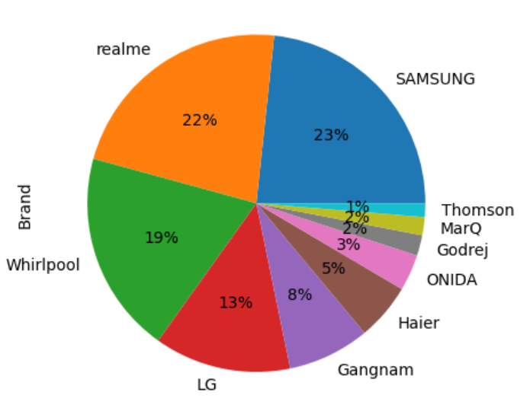
Uni-Variate Analysis:
In the above plot mean is greater than
the meadian and kde line is more
towards right which is due to outliers.
The given pie chart shows t he percentage of the Brands which are having more sales in the market.

Slide 12
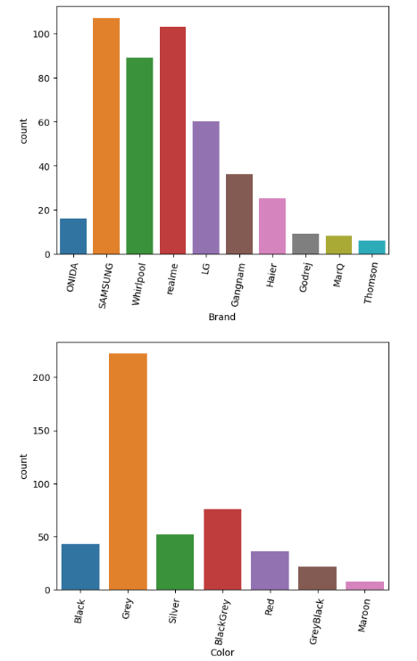
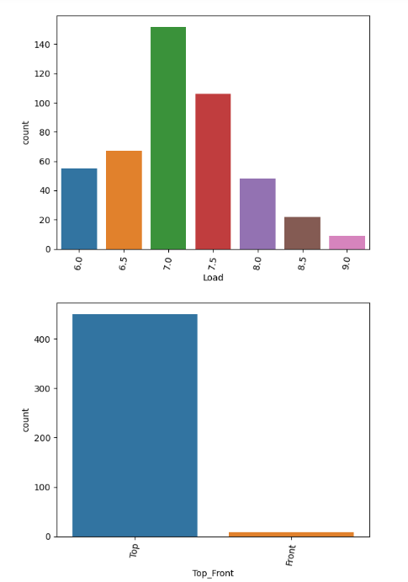

Slide 13
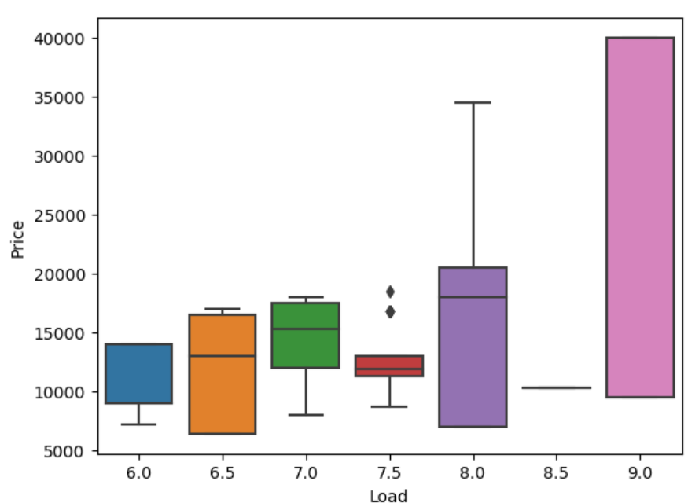
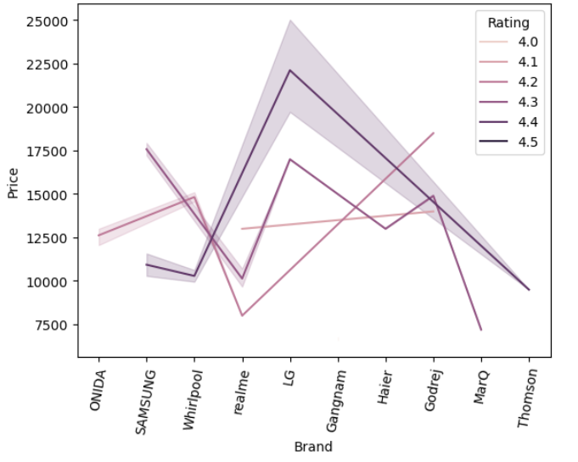
Bi-Variate Analysis:
Multi-Variate analysis:
From the above plot 9 kg load has maximum price and 6.5 kg has minimum price .
From the above graph we can observe that LG has maximum price.

Slide 14
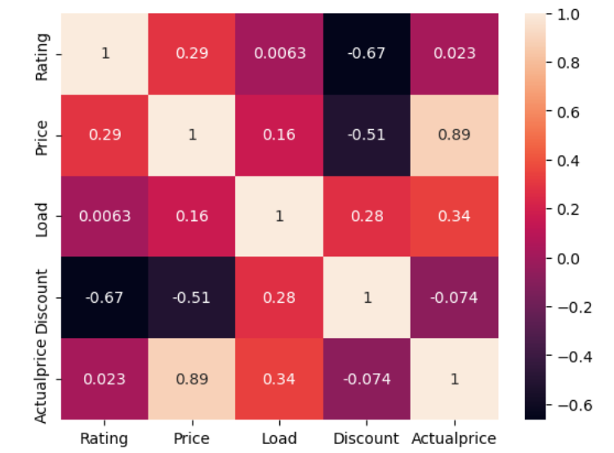
From the plot we can observe that Rating and Price are moderately positively correlated
Discount and Price are high negatively correlated

Slide 15
Challenges Faced:
While doing webscraping we faced lot of difficulties to extract
the data initially.
By using regressions we extracted the data easily
By using Container method we can extract the data very easily
p=soup.findall("div",class="_2kHMtA")
ratings=[]
for i in p:
rating=i.find("li",class_="rgWa7D") if rating:
ratings.append(rating.text)
else:
ratings.append(np.nan)

Slide 16
Conclusion:
The highest cost of a washing machine is IFB and it is 33,490
The lowest cost of a washing machine is Gangnam and it is 6,390
We can say that the Samsung , Grey colour & Top_ 7 kg Load has
highest sale while compared to other brands and it is 15,790

Slide 17

Thank
you

